Slide 1


Response to Scott Barrett
Research Workshop on Governance of the Deployment of Solar Geoengineering
Stefan Schäfer
Harvard University, September 27th, 2018 stefan_schaefer@hks.harvard.edu

Slide 2
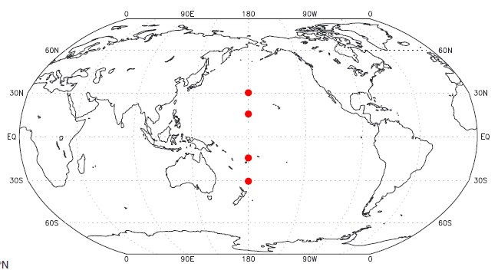
The world of geoengineering?
Kravitz et al. 2017, First Simulations of Designing Stratospheric Sulfate Aerosol Geoengineering to Meet Multiple Simultaneous Climate Objectives, in JGR Atmospheres, 122, p. 12,619.

Slide 3
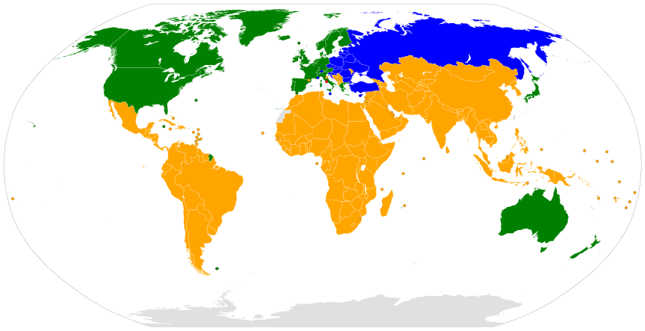
The world of the UNFCCC, 1992
Green and blue: Industrial countries (Annex 1)
Yellow: Developing countries

Slide 4
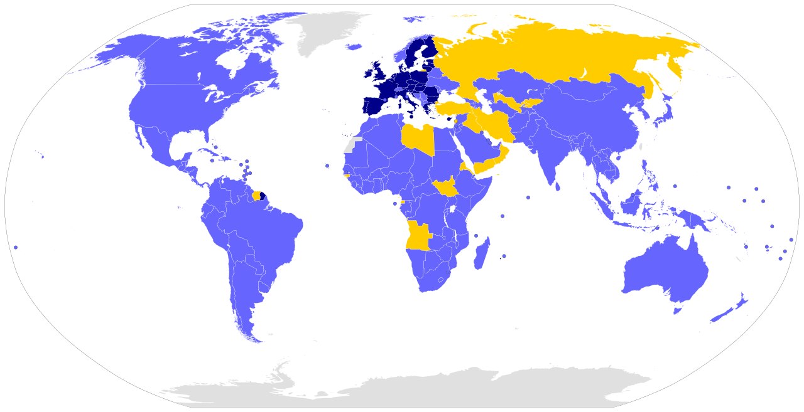
The world of the PA, 2015
Blue and dark blue: State Parties & EU
Yellow: Signatories

Slide 5
“The countries most likely to be affected”—How would you know how you‘re affected?
  Weather becomes blameworthy?
  A regime for „no-fault climate change compensation“ (Wong, Douglas & Savulescu 2014)?

Slide 6
“The countries most likely to be affected“—How would you know how you‘re affected?
  “We have raised many more questions than we are even remotely capable of answering, but we do wish to offer one ‘modest’ proposal, for ‘no fault climate disaster insurance.’ If a large segment of the world thinks the benefits of a proposed climate modification scheme outweigh the risks, they should be willing to compensate those (possibly even a few of themselves) who lose their favored climate (as defined by past statistics), without much debate as to whether the losers were negatively affected by the scheme or by the natural course of the climate. After all, experts could argue both sides of cause and effect questions and would probably leave reasonable doubts in the public's mind.” (Kellogg and Schneider 1974)

Slide 7
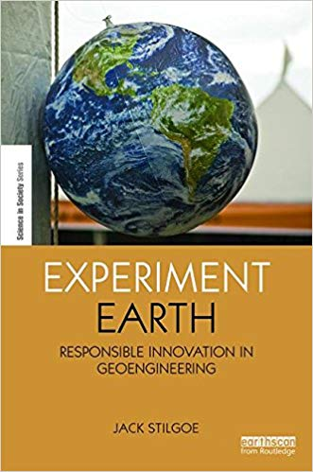
Stilgoe 2014

Slide 8
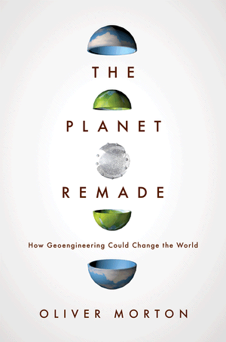
Morton 2015

Slide 9

“From One Earth to One World”
WCED 1987

Slide 10
The world according to geoengineering?
Kravitz et al. 2017, First Simulations of Designing Stratospheric Sulfate Aerosol Geoengineering to Meet Multiple Simultaneous Climate Objectives, in JGR Atmospheres, 122, p. 12,619.

Slide 12
“The countries most inclined to geoengineer”—which are those?
  Who is the free driver?
  Who would find geoengineering the “right” thing to do?

Slide 13
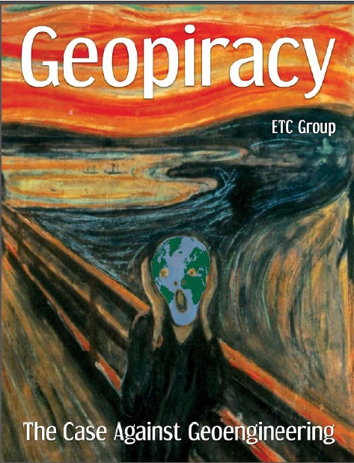
ETC Group 2010, Geopiracy

Slide 14
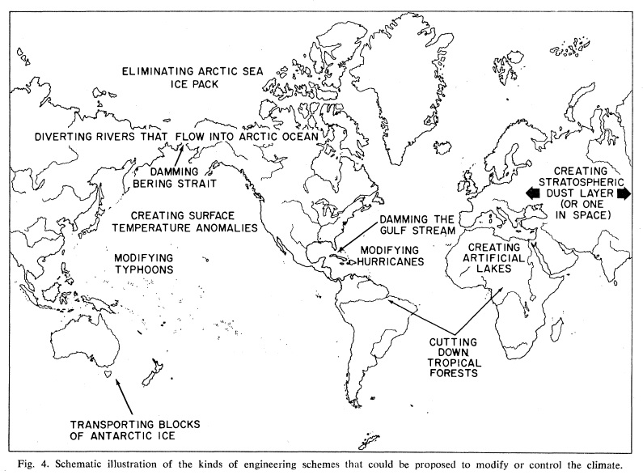
Kellogg and Schneider 1974, Climate Stabilization: For Better or for Worse? In Science 186: 4170, p. 1136

